Slide 1
Restaurant Visitor Forecasting
By Team Akatsuki:-
-Aditya Satam
-Shubham Ahlawat
-Mohit Choudhary

Slide 2
Given: Hot Pepper Gourmet (hpg) - Users can search restaurants and also make a reservation online. AirREGI / Restaurant Board (air) - A reservation control and cash register system.
Mission statement: Use reservation and visitation data to predict the total number of visitors to a restaurant for future dates.

Slide 3
Index
1. Introduction
2. Understanding the data
a. Air Reserve csv
b. Hpg Reserve csv
c. Air Store csv
d. Hpg Store csv
e. Store Id csv
f. Date info csv
3. Engineered Features and the Final Set of Features

Slide 4

Introduction
The aim is to predict the future number of visitors come to restaurants.
The data has 6 files collected from 2 seperated website: Hot Pepper Gourmet (hpg), AirREGI / Restaurant Board (air).
Those files are:
- air_reserve.csv
- hpg_reserve.csv
- air_store_info.csv
- hpg_store_info.csv
- store_id_relation.csv
- date_info.csv

Slide 5
Observation Summary from EDA:
1. Training Dataset Overview:-
-Total number of unique AIR restaurants:- 829
-Total restaurants common in AIR and HPG:- 150
-Total unique genre in AIR restaurants:- 14
-Total number of AIR restaurant’s locations:- 103
-Average daily visitors:- 20.9
-Training data duration:- 2016–01–01 to 2017–04–22
2. Test Dataset Overview:-
-Total unique restaurants:- 821
-Test data duration:- 2017–04–23 to 2017–05–31

Slide 6
3. No. of visitors increases in 2017 as compared to 2016.
4. Almost 90% of the restaurants have less than 40 visitors/day.
5. The spread of AIR reservations is higher than that of HPG reservations.
6. The number of unreserved visitors is far more than the number of reserved visitors.
7. No. of visitors are very low on monday and increases very much in weekends(Friday, Saturday) but decreases on sunday.
8. March and December have highest no. of visitors and may and June has less no. of visitors.
9.The mean and 75% of no. of visitors is below or equal to 6, but max is 100 visitors, so it contain outliers which we removed.

Slide 7
10. There are 14 unique genre, out of which Izakaya is most popular followed by Cake/Sweets genre.
11. International cuisine, Asian, and Karaoke/Party are the least preferred genre having only 0.2% each.
12. We observed hike of no. of visitors at the end of the each month.
13. We have more no. of visitors on holiday than on the working day.
14. The highest number of visitors are on evening time.

Slide 8
Feedback From Previous Presentation:
1. Work on cuisine dataset: so we divided all the cuisine rank-wise wrt no. of visitors and add this to our final set of features.
2. Previously there was a mistake we thought that restaurants are closed on holidays, but this is not true, and we have now concluded that there is an increase in no. of visitors on holidays compare to non holidays.
3. We also divide all the area into ranks named Location Rank and add it to our final set of features.

Slide 9
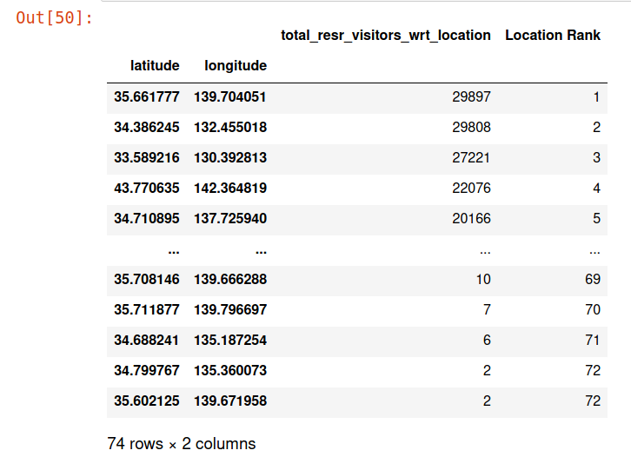
Location Rank

Slide 10
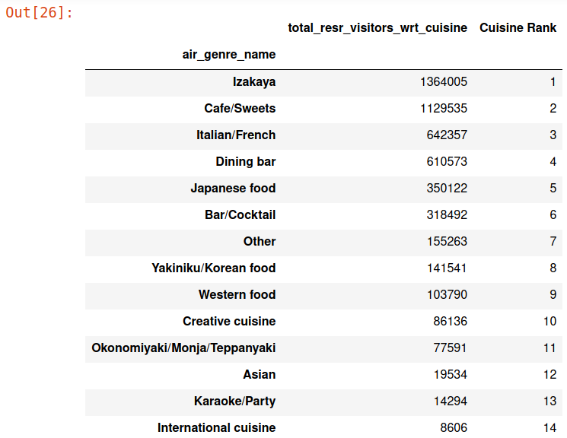
Cuisine Rank

Slide 11
Train Data Summary:
Train.csv:
3 features, 3,39,673 records
air_store_id, visit_datetime, visitors
Air Store Info.csv:
7 features, 2,39,673 records.
latitude, longitude, air_genre_name, air_area_name
Observation: air_genre_name, air_area_name are object type in nature so we include these features as integer type after encoding it.

Slide 12
group on air_genre_name & calculate sum of visitors to add cuisine_rank & remove air_genre_name from feature set. 7 features 2,39,673 records. air_store_id, visit_datetime, visitors, latitude, longitude, cuisine_rank, air_area_name

Slide 13
group on air_area_name & calculate sum of visitors to add location_rank & remove air_area_name from feature set 7 features 2,39,673 records. air_store_id, visit_datetime, visitors, latitude, longitude, cuisine_rank, location_rank date info.csv 9 features 2,39,673 records. air_store_id, visit_datetime, visitors, latitude, longitude, cuisine_rank, location_rank holiday_flg, week_days

Slide 14
air_reserve.csv + hpg_reserve.csv 10 features 2,39,673 records. air_store_id, visit_datetime, visitors, latitude, longitude, cuisine_rank, location_rank holiday_flg, week_days reserve_visitors remove string type features: air_store_id, visit_datetime final train-> 8 features 2,39,673 records. visitors, latitude, longitude, cuisine_rank, location_rank holiday_flg, week_days reserve_visitors

Slide 15
Model: XGBoost model score 0.62 rsmle 0.67 Hyperparameter tuning model score 0.63 rsmle 0.66 Observation: Two important features(air_store_id, visit_datetime) were dropped from train_x due to string type so include them as integer type in the final feature set. encode objects in integer type to identify distinct air_store_id values using factorize from air_store_info.csv & break visit_datetime into 3 features(year, month, day) using str & convert into integer type using astype

Slide 16
final train-> 12 features 2,39,673 records: visitors, latitude, longitude, cuisine_rank, location_rank holiday_flg, week_days reserve_visitors air_restaurant_id, year, month, day XGBoost model score 0.72 rsmle 0.504 Another Observation: There is a huge leap in score on adding two important features(air_store_id, visit_datetime) as integer type in the final feature set so need to find more good features to add up.

Slide 17
group on air_store_id & calculate mean of visitors to add mean_visitors_wrt_ids into feature set. final train-> 13 features 2,39,673 records: visitors, latitude, longitude, cuisine_rank, location_rank holiday_flg, week_days reserve_visitors air_restaurant_id, year, month, day, mean_visitors_wrt_ids XGBoost Model score 0.73 rsmle 0.501

Slide 18
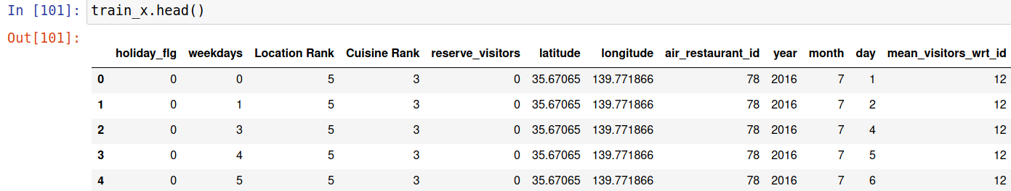
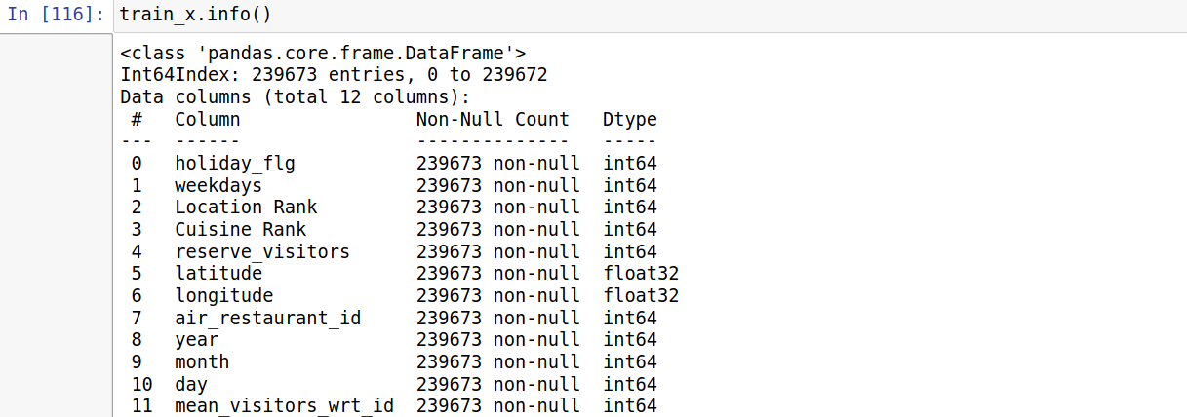
Train_x data & structure:

Slide 19
Test Data Summary: sample_submission.csv 2 features 12,435 records. id, visitors break id into 2 features(air_store_id, visit_datetime) using str & convert into integer type using astype. 4 features 12,435 records: id, visitors air_store_id, visit_datetime rest is similar to train data

Slide 20
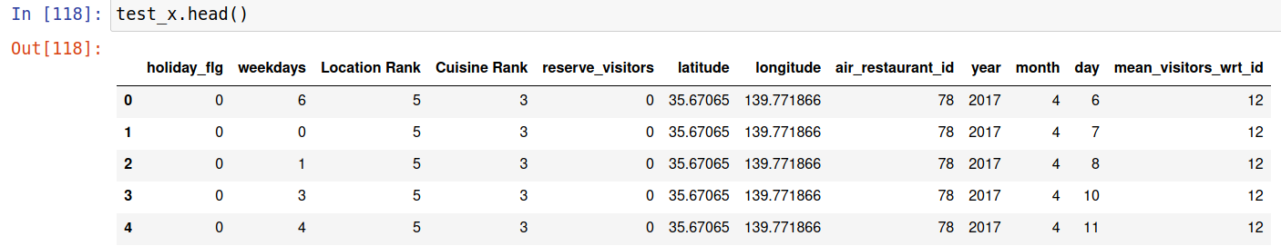
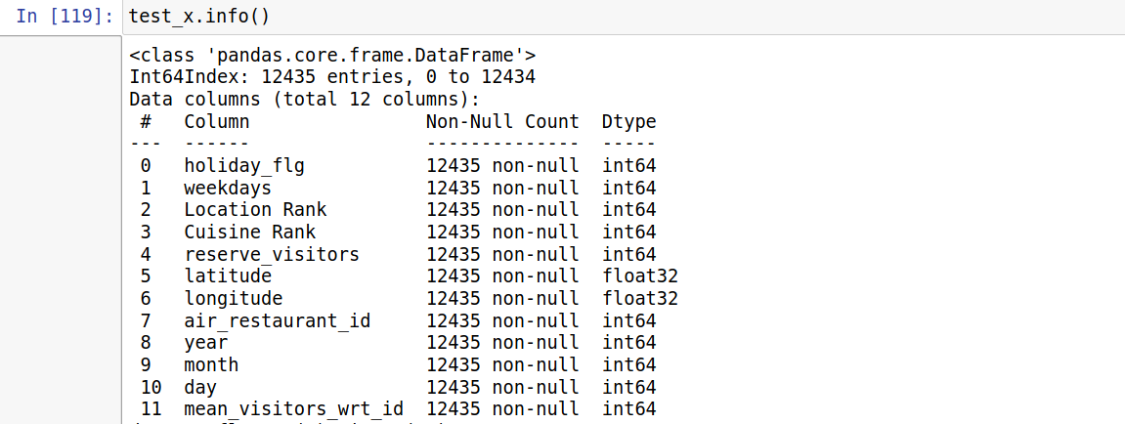
Test_x data & structure:

Slide 21
Model Selection:
1. XGBoost Model
2. Decision Tree Regression
3. Random Forest Regression
4. Kneighbours Regression

Slide 22
XGBoost
It stands for eXtreme Gradient Boosting. Gradient boosting is an ensemble approach where new models are created that predict the residuals or errors of prior models and then added together to make the final prediction. “As the winner of an increasing amount of Kaggle competitions, XGBoost showed us again to be a great all-round algorithm worth having in your toolbox ”
On hyperparameter tuning, we found out
Max Depth = 8
Learning rate = .009

Slide 23
DECISION TREE REGRESSION
Decision tree builds regression or classification models in the form of a tree structure. It breaks down a dataset into smaller and smaller subsets while at the same time an associated decision tree is incrementally developed. The final result is a tree with decision nodes and leaf nodes.
On hyperparameter tuning, we found out
Max Depth = 40
Min_sample_split = 10
Here also we used (log(y)) as it helps a decision tree to pack values in a leaf because the values are “closer” to each other.

Slide 24
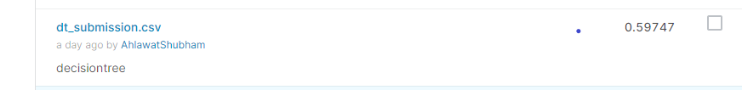
First using decision tree regression we are getting
RMSLE – 0.71
Score – 0.61
After adding some more features in train data ,
RMSLE - 0.63
Performing hypertuning
RMSLE – 0.61
Final RMSLE – 0.59.

Slide 25
RANDOM FOREST REGRESSION
A random forest is a meta estimator that fits a number of classifying decision trees on various sub-samples of the dataset and uses averaging to improve the predictive accuracy and control over-fitting.
On hypertuning we found out that
max_depth =45
n_estimators =60
Here also we used log(y) .

Slide 26
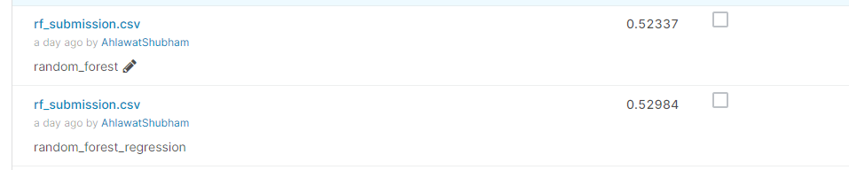
First using Random Forest Regression we are getting
RMSLE – 0.64
After adding and removing some features in Train data , we got
RMSLE – 0.58
Then performing hypertuning
RMSLE – 0.5298
RMSLE – 0.52337

Slide 27
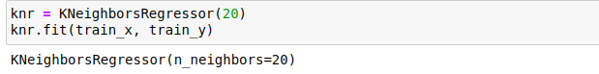
KneighboursRegressor
Regression based on k-nearest neighbors.
The target is predicted by local interpolation of the targets associated of the nearest neighbors in the training set.
Init signature: KNeighborsRegressor(n_neighbors=5, *, weights='uniform', algorithm='auto', leaf_size=30, p=2, metric='minkowski', metric_params=None, n_jobs=None, **kwargs)
We tried various values of hyperparameter, and conclude that the value of n_neighbours = 20 is giving best results.

Slide 28
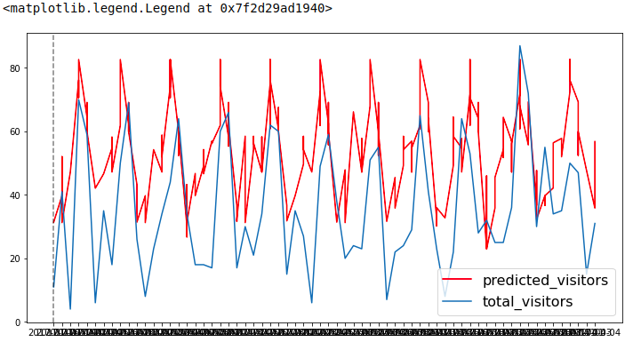
First we separate out the dataset into 2 parts 80% for train data and 20% test data and make a relation between actual visitors and predicted visitors:

Slide 29
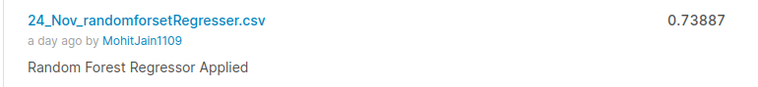
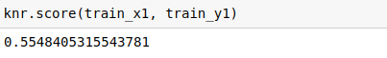
After we train the model and calculate the visitors for the test data, and submission to Kaggle, The Root Mean squared Logarithmic Error is: 0.73887

Slide 30

Comparison of Models:
1. XGBoost
Score: 0.73
RMSLE: 0.499
2. Decision Tree Regression:
Score: 0.61
RMSLE: 0.59
3. Random Forest Regression:
Score: 0.64
RMSLE: 0.52
4. K Neighbour Regressor:
Score: 0.55
RMSLE: 0.73

Slide 31
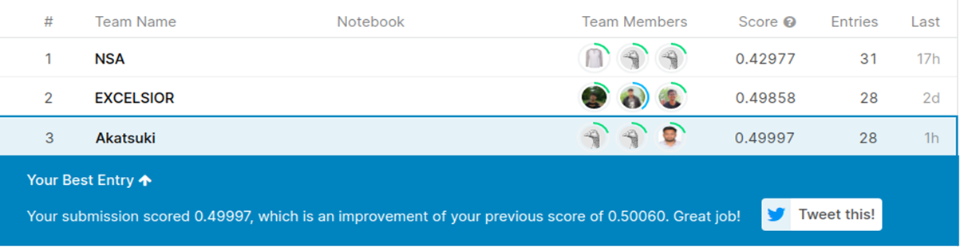
Kaggle Ranking:
-This ranking based upto 27th Nov 2020 4:00 pm.
-We did total of 28 entries in kaggle of these 4 above mention model and XGB perform best out of these.
-We are on the 3rd rank with the RSMLE error of 0.499.

Slide 32
References:
1.https://medium.com/analytics-vidhya/recruit-restaurant-visitor-forecasting-f9ef87ba1073
2.https://www.youtube.com/watch?v=xGoRCVryUDk
3.https://www.youtube.com/watch?v=J_LnPL3Qg70
4.https://pandas.pydata.org/
5.https://www.youtube.com/user/dataschool
6.https://www.youtube.com/channel/UCh9nVJoWXmFb7sLApWGcLPQ

Slide 33
Thank You

